Slide 1
Analysis of IQL: Local Stability
Information and Intelligence Systems Lab.
Electronic Engineering, Hanyang University

Slide 2
Contents
About IQL
- Description of IQL
- What types of errors are induced?
Two factors for Stability: First order analysis of perturbation
- Perturbation analysis: critic errors and residual errors
- Error through Bellman iteration
Local Stability
- Finite-Horizon Local Stability

Slide 3
About IQL

Slide 4
Objective
Find out what the factors which makes the IQL unstable are
and how Kostrikov et al. overcome these drawbacks.
Derive the stability theorem when IQL local stability is established
and what the effect of increasing the number of critics is

Slide 5
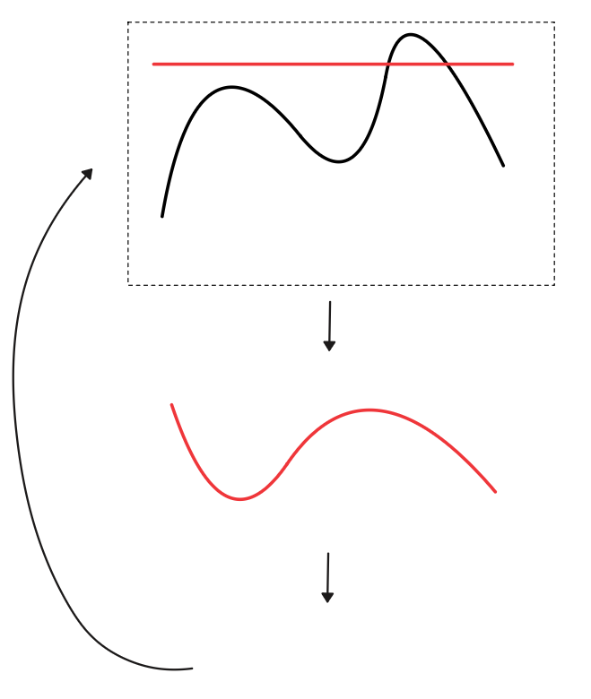




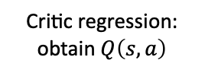
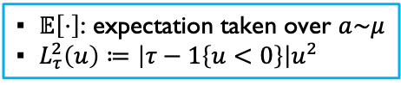

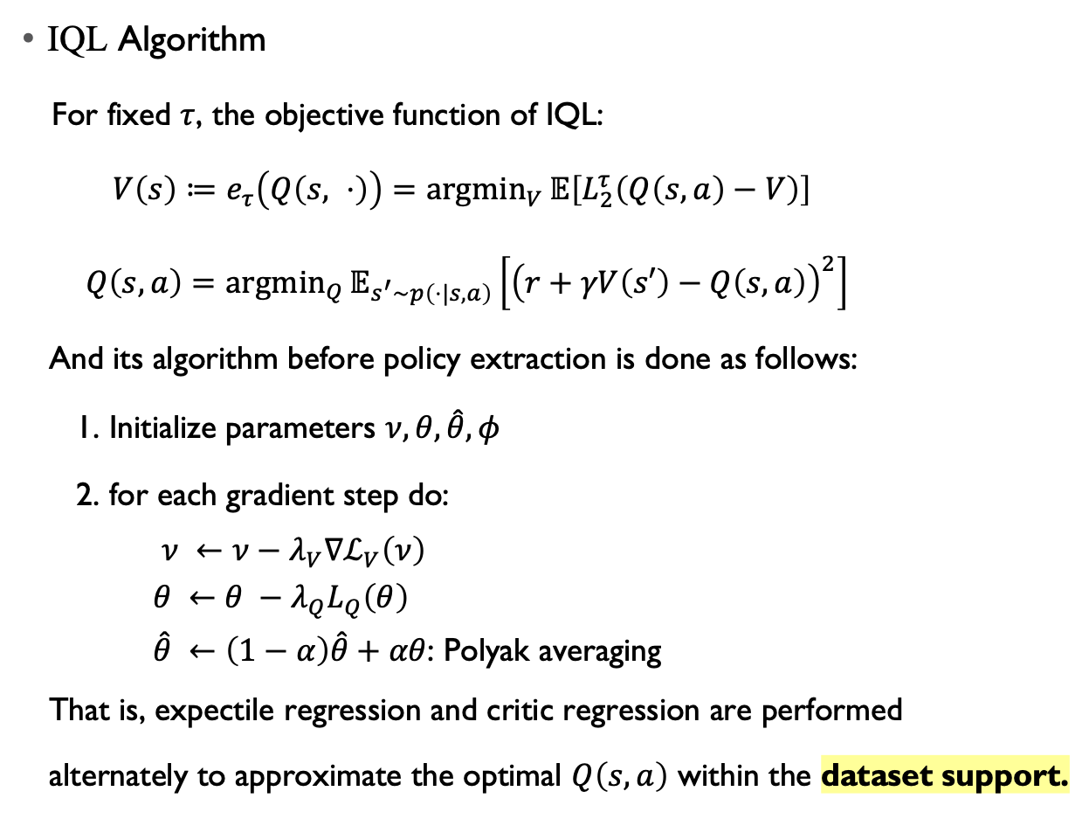

Description of IQL
IQL Algorithm
For fixed $τ$, the objective function of IQL:
$V\left(s\right)≔e_{τ}\left(Q\left(s, ⋅\right)\right)=\underset{V}{argmin}{𝔼\left[L_{2}^{τ}\left(Q\left(s,a\right)−V\right)\right]}$
$Q\left(s,a\right)=\underset{Q}{argmin}{𝔼_{s^{′}\sim p\left(⋅|s,a\right)}\left[{\left(r+γV\left(s′\right)−Q\left(s,a\right)\right)}^{2}\right]}$
And its algorithm before policy extraction is done as follows:
1. Initialize parameters $ν, θ, \hat{θ}, φ$
2. for each gradient step do:
$ν ←ν−λ_{V}∇ℒ_{V}\left(ν\right)$
$θ ←θ −λ_{Q}L_{Q}\left(θ\right)$
$\hat{θ} ←\left(1−α\right)\hat{θ}+αθ$: Polyak averaging
That is, expectile regression and critic regression are performed
alternately to approximate the optimal $Q\left(s,a\right)$ within the dataset support.
▪︎ $𝔼\left[⋅\right]$: expectation taken over $a\sim μ$
▪︎ $L_{τ}^{2}\left(u\right)≔\left|τ−1\left\{u<0\right\}\right|u^{2}$
Fixed $s∈𝒮$ and $τ∈\left(0, 1\right)$
$$v≔V(s)$$
$$Q\left(s,a\right)=:q$$
$$a$$
Repeat over $s$
$$V(s^{′})$$
Critic regression:
obtain $Q\left(s,a\right)$

Slide 6
What types of error are induced?
In the case of IQL, several types of errors may arise during training:
- Sampling error
- Regression fitting error from critic and expectile regression
- Stochastic error induced during neural network optimization
Since our analysis focuses on the in-sample problem defined by a fixed offline dataset, we do not
consider sampling error.
We investigate how the remaining errors affect the stability of IQL.

Slide 7
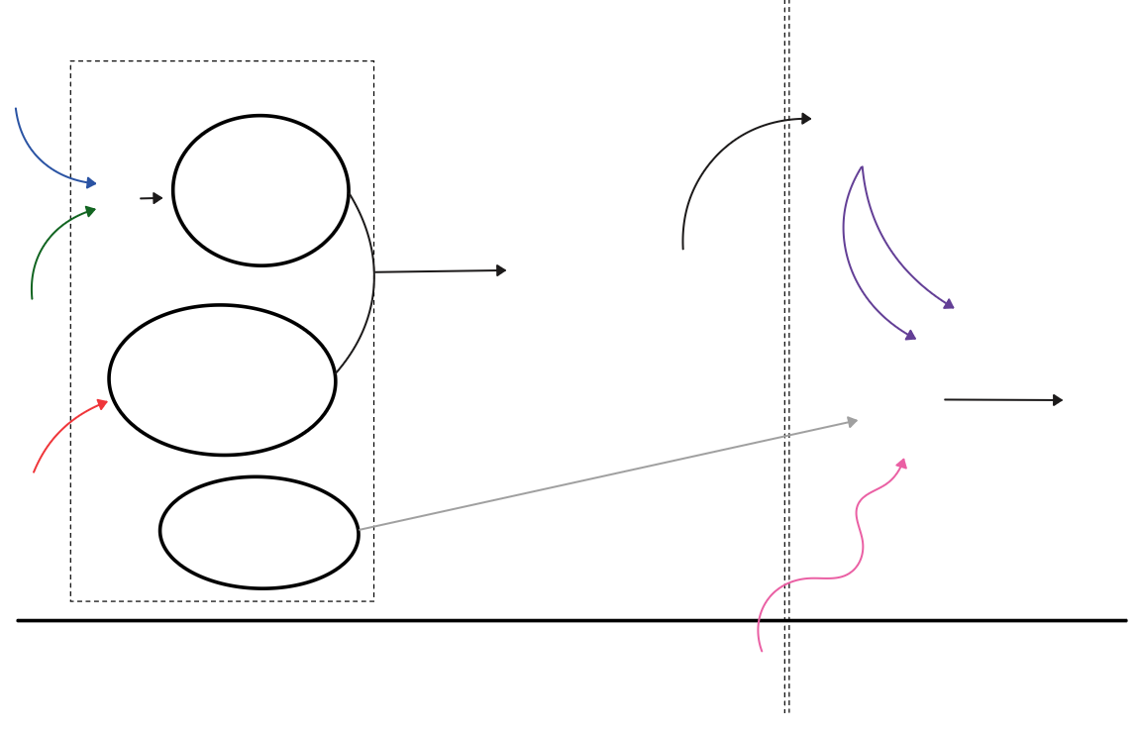









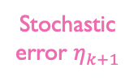


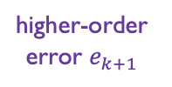




What types of error are induced?
In this figure, Bellman equation is
$$Q\left(s,a\right)=r+γ𝔼\left[V\left(s^{′}\right)\right]$$
Expectile regression with fixed $s$ and $τ$
Stochastic error
Critic fitting error
Sensitivity of expectile
Apply
Bellman equation
$$ζ_{k,τ}$$
$$Δ_{τ}^{res}=\tilde{v}−v$$
$$g_{k}\left(s\right)≔{\tilde{V}}_{k,τ}\left(s\right)−V_{k,τ}\left(s\right)$$
First-order error
$$γB_{k}g_{k}$$
Repeated over $s$
expectile fitting error
Objective displacement
$$Δ=\hat{v}−v$$
higher-order error $e_{k+1}$
$$\hat{q}=q+ε_{k}$$
$$ε_{k+1}$$
$$ρ_{k, τ}$$
Critic error $ε_{k}$
Apply
Bellman equation
Higher order remainder $r_{k, τ}$
Stochastic error $η_{k+1}$
Bellman iteration $k$
$$k+1$$

Slide 8
Two factors for Stability
- First order analysis of perturbation -

Slide 9

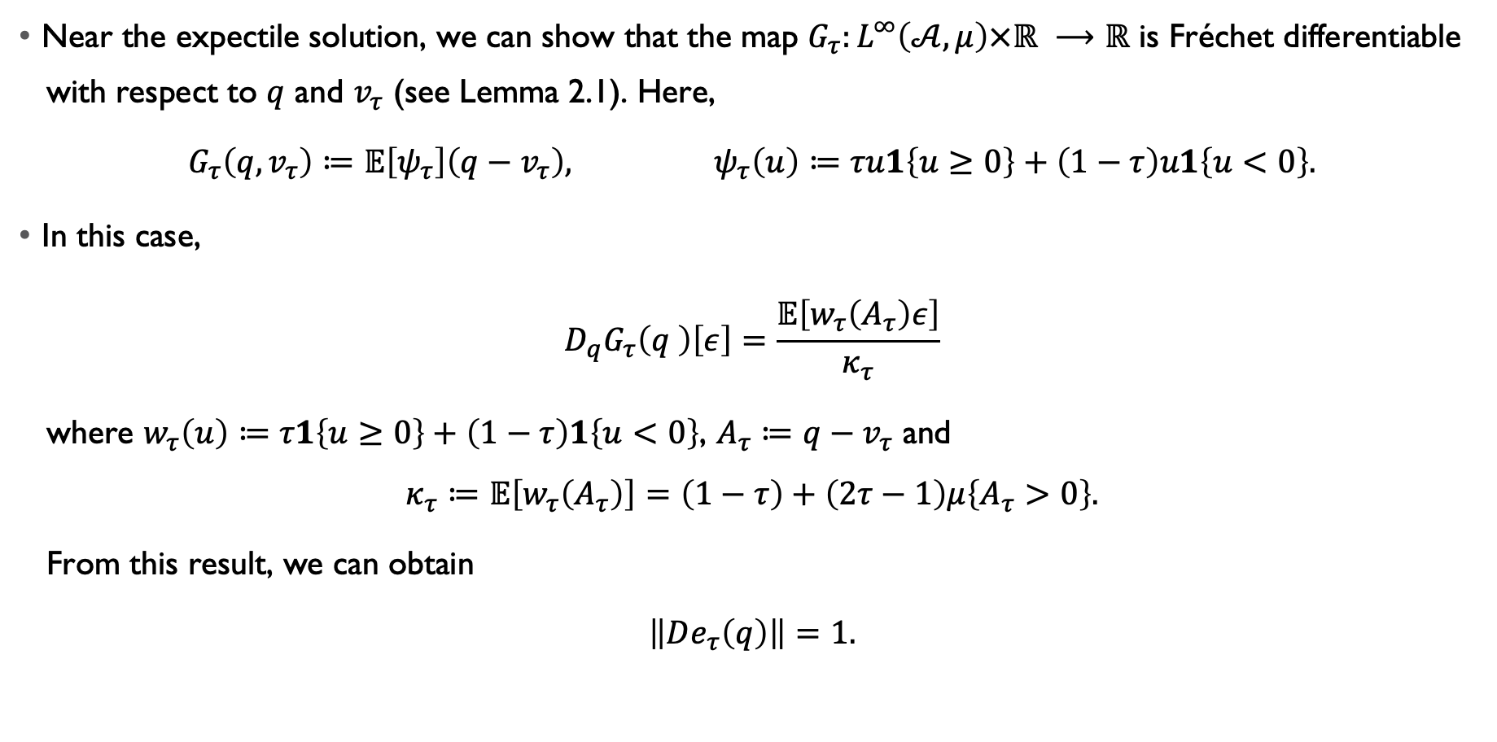
Perturbation analysis: critic errors and residual errors
Fixed state case
Near the expectile solution, we can show that the map $G_{τ}:L^{∞}\left(𝒜,μ\right)×ℝ ⟶ℝ$ is Fréchet differentiable
with respect to $q$ and $v_{τ}$ (see Lemma 2.1). Here,
$$G_{τ}\left(q,v_{τ}\right)≔𝔼\left[ψ_{τ}\right]\left(q−v_{τ}\right), ψ_{τ}\left(u\right)≔τu1\left\{u≥0\right\}+\left(1−τ\right)u1\left\{u<0\right\}.$$
In this case,
$$D_{q}G_{τ}\left(q \right)\left[ε\right]=\frac{𝔼\left[w_{τ}\left(A_{τ}\right)ε\right]}{κ_{τ}}$$
where $w_{τ}\left(u\right)≔τ1\left\{u≥0\right\}+\left(1−τ\right)1\left\{u<0\right\}$, $A_{τ}≔q−v_{τ}$ and
$$κ_{τ}≔𝔼\left[w_{τ}\left(A_{τ}\right)\right]=\left(1−τ\right)+\left(2τ−1\right)μ\left\{A_{τ}>0\right\}.$$
From this result, we can obtain
$\left\|De_{τ}\left(q\right)\right\|=1.$
Weighted avg of $ε$

Slide 10
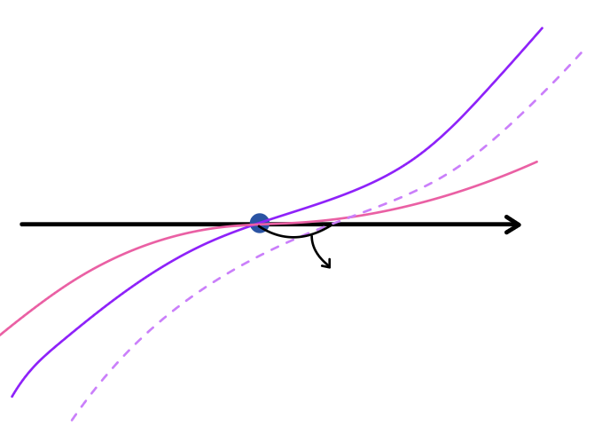

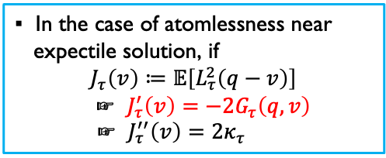

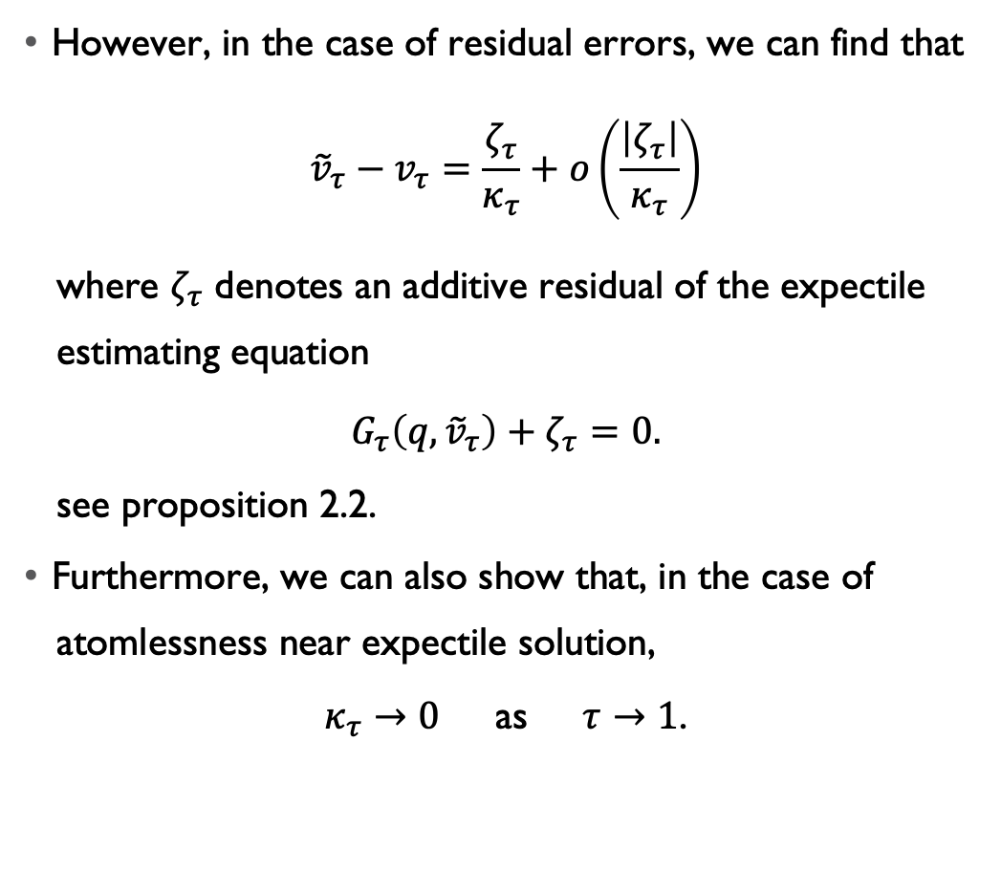


Perturbation analysis: critic errors and residual errors
Fixed state case
However, in the case of residual errors, we can find that
$${\tilde{v}}_{τ}−v_{τ}=\frac{ζ_{τ}}{κ_{τ}}+o\left(\frac{\left|ζ_{τ}\right|}{κ_{τ}}\right)$$
where $ζ_{τ}$ denotes an additive residual of the expectile
estimating equation
$$G_{τ}\left(q,{\tilde{v}}_{τ}\right)+ζ_{τ}=0.$$
see proposition 2.2.
Furthermore, we can also show that, in the case of
atomlessness near expectile solution,
$κ_{τ}→0$ as $τ→1$.
$$τ→1$$
$$v_{τ}$$
$$v$$
$$ζ_{τ}$$
▪︎ In the case of atomlessness near
expectile solution, if
$$J_{τ}\left(v\right)≔𝔼\left[L_{τ}^{2}\left(q−v\right)\right]$$
☞ $J_{τ}^{′}\left(v\right)=−2G_{τ}\left(q,v\right)$
☞ $J_{τ}^{′′}\left(v\right)=2κ_{τ}$

Slide 11
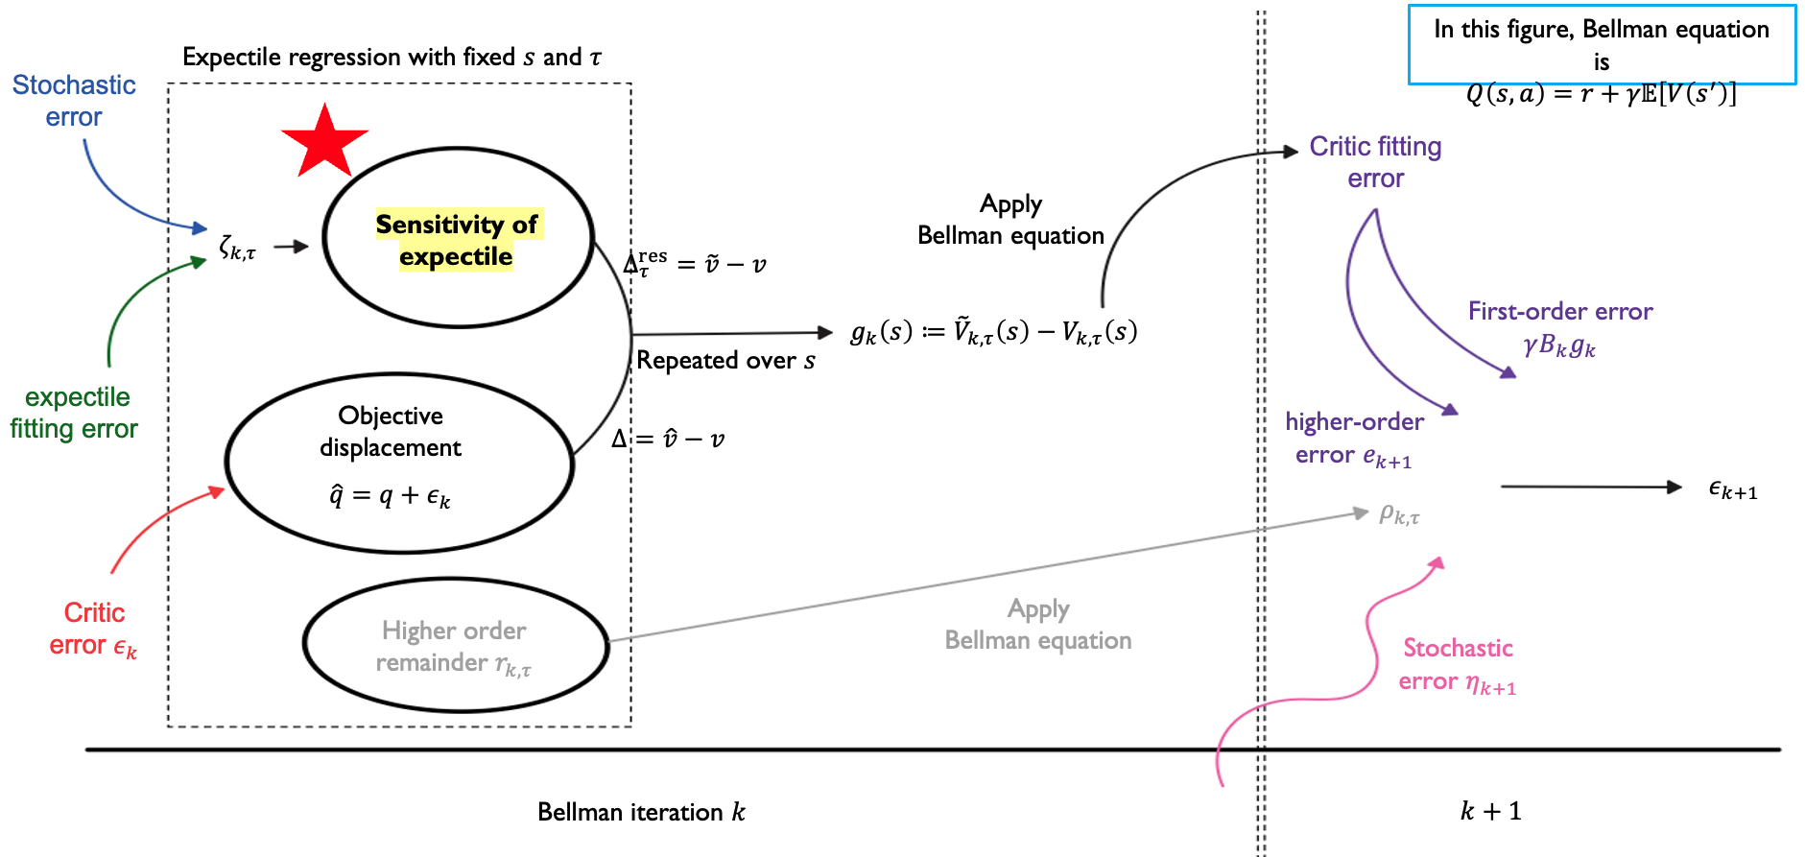
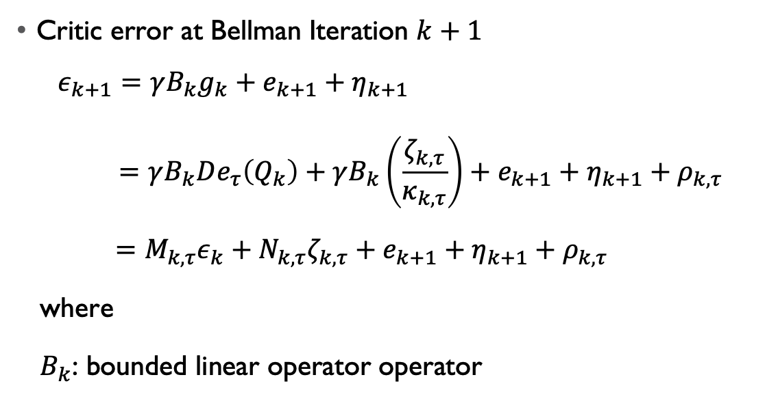


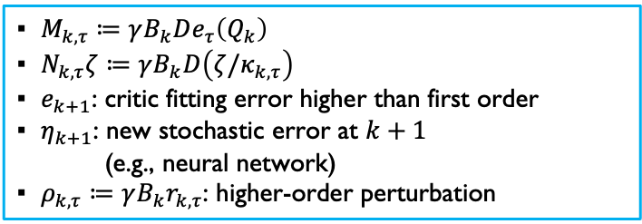
Error through Bellman iteration
Critic error at Bellman Iteration $k+1$
$$ε_{k+1}=γB_{k}g_{k}+e_{k+1}+η_{k+1}$$
$$=γB_{k}De_{τ}\left(Q_{k}\right)+γB_{k}\left(\frac{ζ_{k,τ}}{κ_{k, τ}}\right)+e_{k+1}+η_{k+1}+ρ_{k,τ}$$
$$=M_{k, τ}ε_{k}+N_{k,τ}ζ_{k,τ}+e_{k+1}+η_{k+1}+ρ_{k,τ}$$
where
$B_{k}$: bounded linear operator operator
▪︎ $M_{k,τ}≔γB_{k}De_{τ}\left(Q_{k}\right)$
▪︎ $N_{k,τ}ζ≔γB_{k}D\left(ζ/κ_{k,τ}\right)$
▪︎ $e_{k+1}$: critic fitting error higher than first order
▪︎ $η_{k+1}$: new stochastic error at $k+1$
(e.g., neural network)
▪︎ $ρ_{k,τ}≔γB_{k}r_{k,τ}$: higher-order perturbation
error to be
entered to
Bellman equation
$$B_{k}$$
First-order error of its result
$$e_{k+1}$$

Slide 12
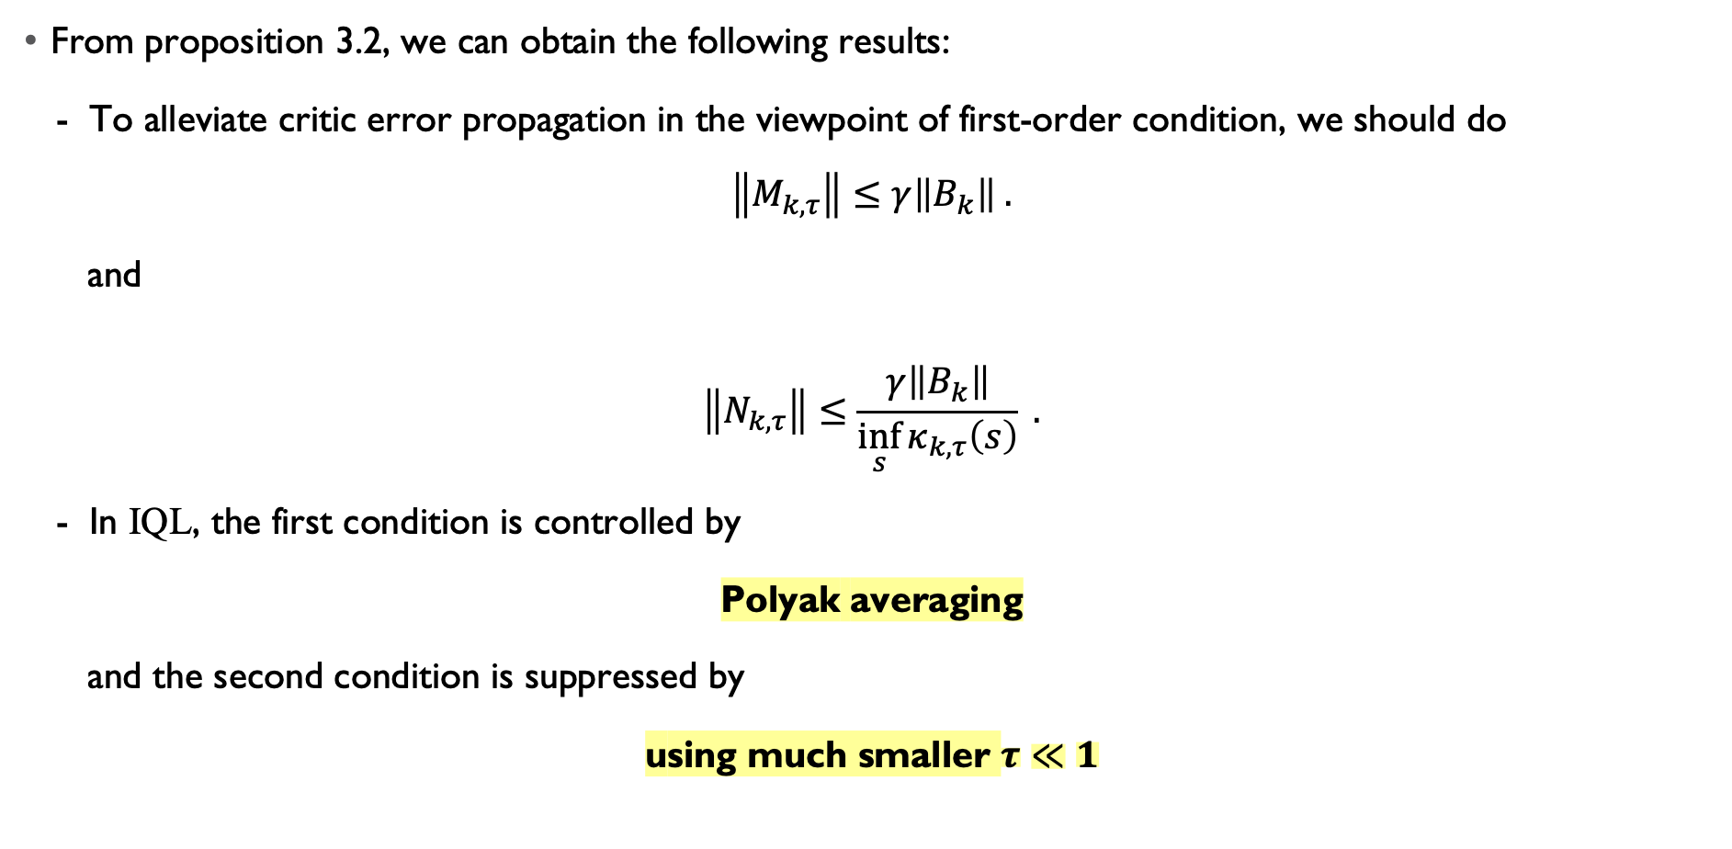
Error through Bellman iteration
From proposition 3.2, we can obtain the following results:
- To alleviate critic error propagation in the viewpoint of first-order condition, we should do
$$\left\|M_{k, τ}\right\|≤γ\left\|B_{k}\right\| .$$
and
$$\left\|N_{k, τ}\right\|≤\frac{γ\left\|B_{k}\right\|}{\inf_{s}{κ_{k,τ}\left(s\right)}} .$$
- In IQL, the first condition is controlled by
Polyak averaging
and the second condition is suppressed by
using much smaller $τ≪1$

Slide 13
Local Stability

Slide 14
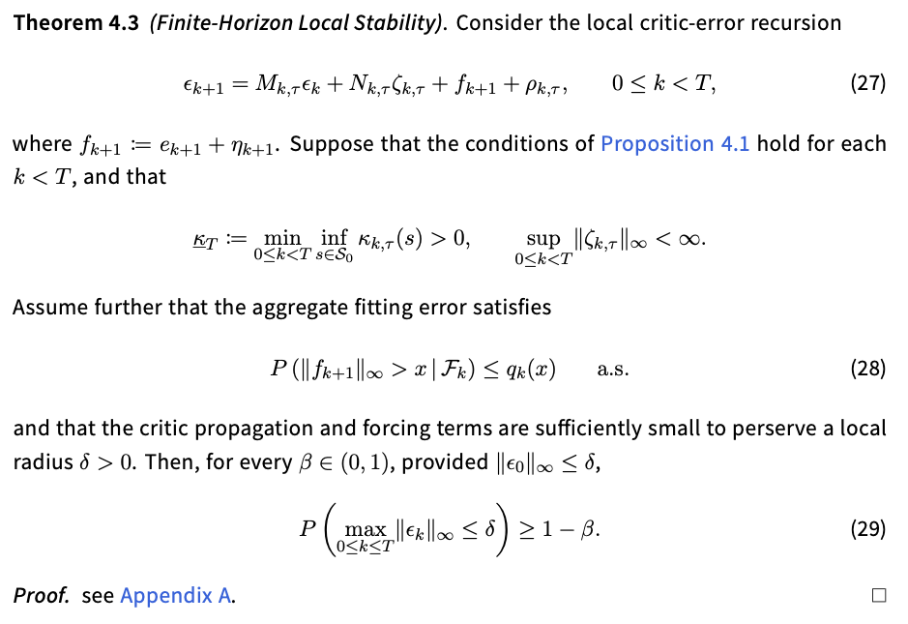
Finite-Horizon Local Stability

